Slide 1

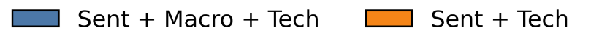
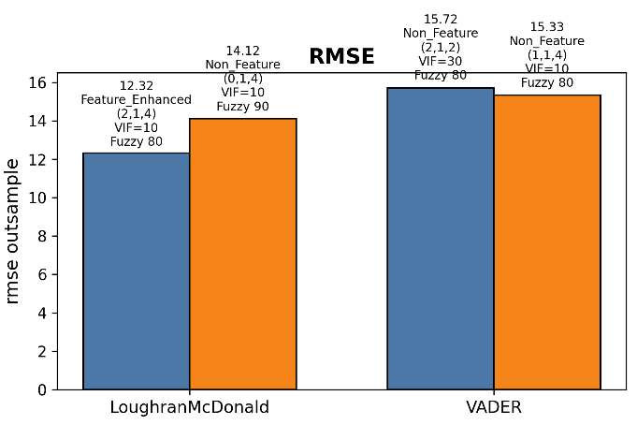
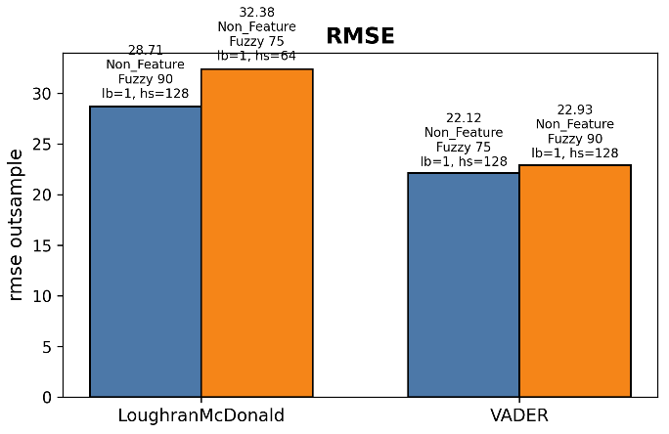
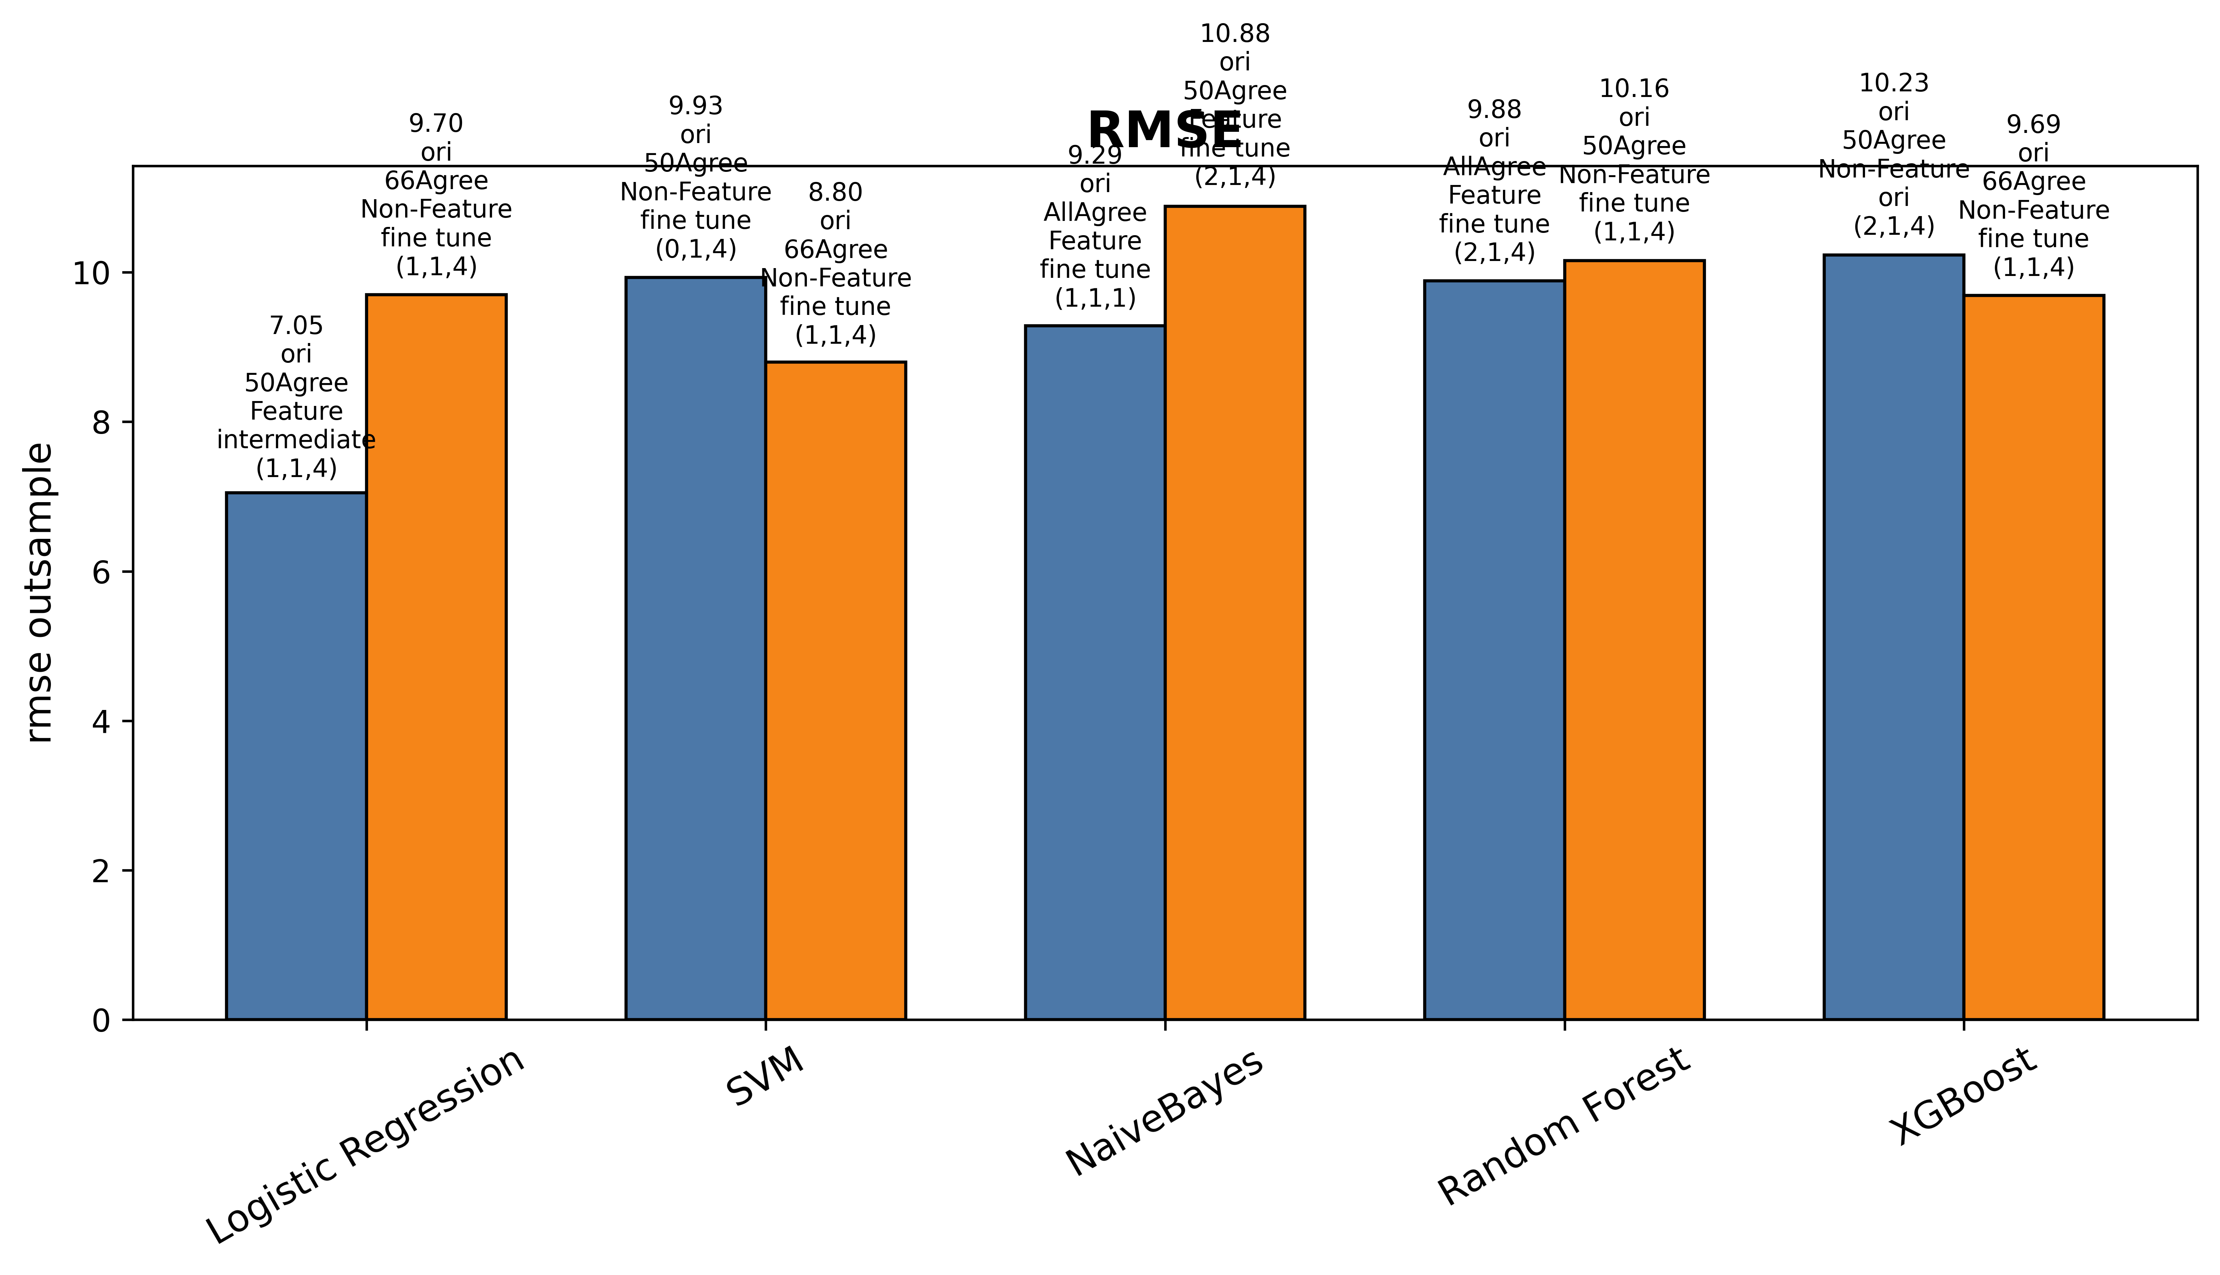

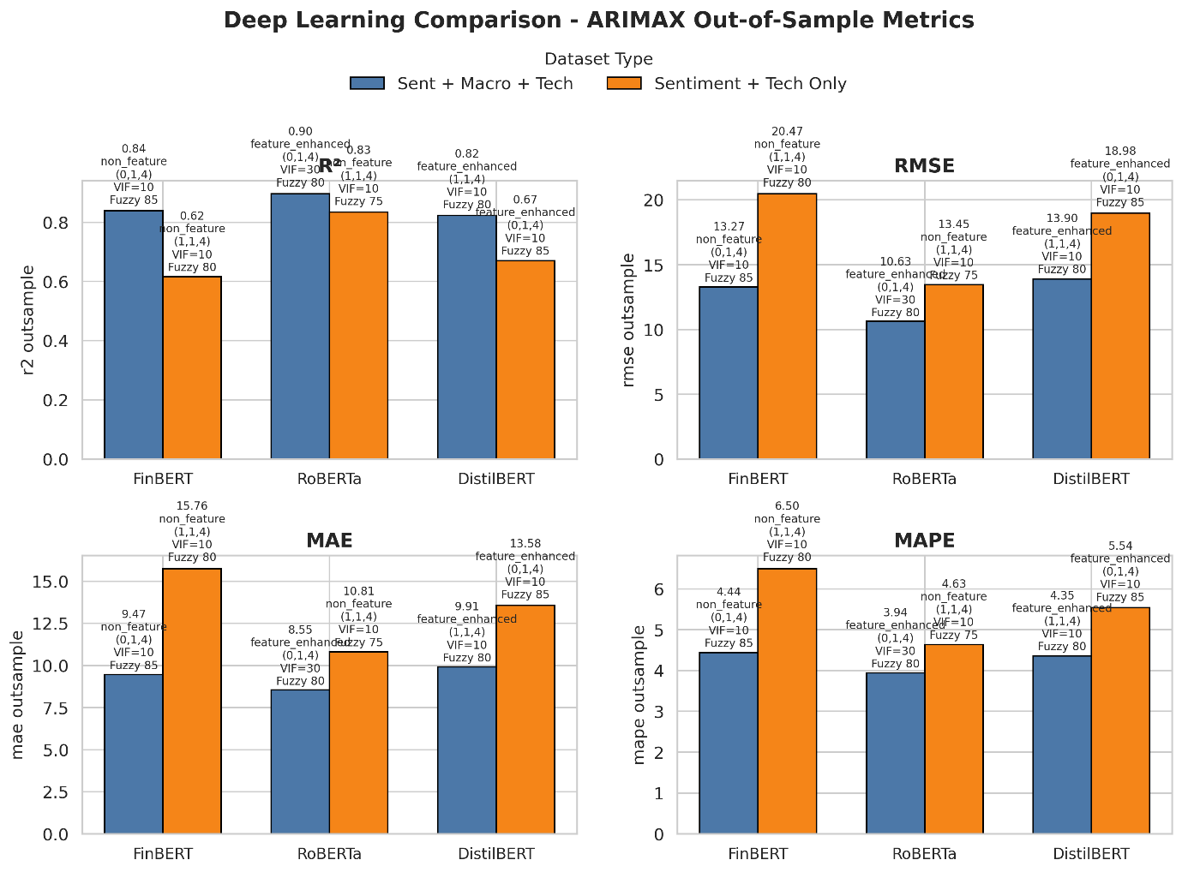
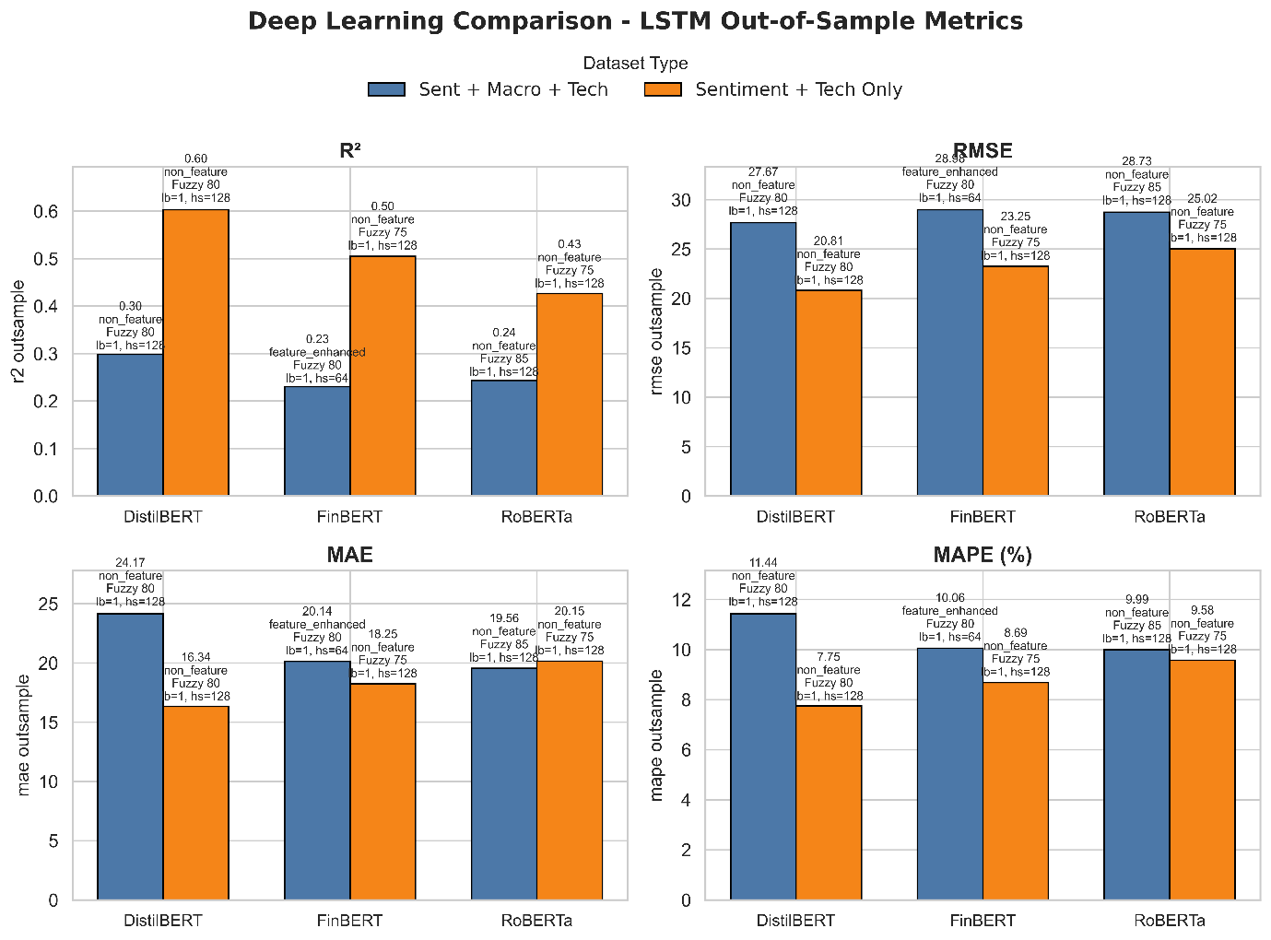
Statistical and Deep Learning Models for Sentiment-Based Market Price
Lai Chun Kit¹, Loy Kak Choon²
^{1,2}Faculty Computer Science and Mathematics, Universiti Malaysia Terengganu, 21030 Kuala Nerus, Terengganu, ¹ s65947@ocean.umt.edu.my
ABSTRACT
This study investigates the influence of sentiment analysis combined with macroeconomic and technical factors on the prediction of Tesla stock price. The financial‐news headlines (2020–2023) fetched by using GDELT, then translated and deduplicated headlines, and derived sentiment features using three methods: lexicon‐based (VADER, Loughran–McDonald), machine‐learning classifiers (Logistic Regression, SVM, Naive Bayes, Random Forest, XGBoost) trained over Financial PhraseBank along with TF‐IDF, Bag‐of‐Words and Word2Vec representations (tuned using grid search), and deep‐learning embeddings (FinBERT, RoBERTa, DistilBERT). The best sentiment models were chosen based on classification accuracy, precision and recall. They aggregated the monthly sentiment scores with macro indicators nd technical indicators, and then they fed them into the ARIMAX and LSTM frameworks. Out‐of‐sample metrics (RMSE, MAE, MAPE) reveal that ML‐driven sentiment features consistently outperform lexicon and DL embeddings under both ARIMAX and LSTM. In ARIMAX, including macro indicators is always beneficial for the RMSE (best: Logistic Regression + macro + tech, RMSE ≈ 7.05). For LSTM, we found that only the pipeline Random Forest LSTM (tech‐only) is able to achieve lowest RMSE (≈ 3.89); while most LSTM models such as SVM→LSTM could not utilize macro signals. Deep‐learning embeddings are consistently outperformed by ML across Both models. ML‐based sentiment models are of better predictive value on Financial PhraseBank. For economically informed forecasts, ML ARIMAX (macro+ tech) is recommended ,while for pure RMSE minimization RF→LSTM (tech-only) is the best. This paper has practical implications for analysts and fintech applications.
BACKGROUND OF STUDY
Historical Context
Classical time‐series models (e.g., ARIMA/ARIMAX) can archive linear trends of stock‐prices, but difficulty news‐driven step shifts (Ren et al., 2019).
Sentiment analysis in financial news (e.g., depending on lexicons like Loughran–McDonald and VADER) has been shown to be promising with respect to short‐term price momentum prediction (Cristescu et al., 2023) but has been critiqued for their lack of contextual sensitivity these tools (Loughran & McDonald, 2011; Hutto & Gilbert, 2014).
OBJECTIVES
Improve Forecast Accuracy: Evaluate how Tesla stock‐price forecasting is improved by integrating sentiment, technical, and macro indicators.
Compare Sentiment Methods: Compare lexicon (VADER, Loughran-McDonald), machine-learning (Logistic Regression, SVM, Random Forest, XGBoost, Naive Bayes), and deep-learning (FinBERT, DistilBERT, RoBERTa) methods.
Identify Optimal Pipeline: Which sentiment method plus technical + macro variables gives the smallest out‐of‐sample errors (RMSE).
Problem Statement
Limited studies have systematically compared lexicon, machine‐learning, and deep‐learning sentiment under both ARIMAX and LSTM frameworks, and most disregard technical indicators, such as RSI, MACD, or remain unable to integrate an extensive range of macro features (CPI, PPI, GDP, unemployment) with sentiment factors.
The computational versus prediction‐accuracy trade‐off (including for deep learning) in real‐time forecasting is not known.
METHODOLOGY
Software tools: Python
Data Sources: GDELT API (headlines), Yahoo Finance (prices), FRED API (macroeconomic variables)
Sentiment Models: Lexicon, ML classifiers on Financial PhraseBank (TF-IDF, BoW, Word2Vec), DL embeddings
Forecasting Models: ARIMAX, LSTM
Data collection
Preprocessing (translate, dedup, tokenize)
Sentiment Extraction
Feature Merge (sentiment + technical + macro)
Model Training
Evaluation (80/20 split; RMSE, MAE, MAPE, R Square)
Visualization & Insights
Conclusion & Recommendations
Relevance and Importance
Finding the best combination between sentiment models and exogenous indicators (technical + macro) for better prediction for portfolio managers, algorithmic traders and fintech firms.
An integrated assessment over lexicon‐based ARIMAX, ML‐classified sentiment, and DL embeddings with LSTM will also be conducted to determine which of the pipelines gives the best out‐of‐sample performance.
These discussions will help practitioners to trade off model accuracy versus available computational resources in financial applications under a real time constraint.
COMPARISON RMSE BARPLOT BETWEEN SENTIMENT MODEL
RESULTS AND DISCUSSION
ARIMAX
LSTM
ARIMAX (all sentiment types): RMSE is always lower when adding macro → macro improves the forecast accuracy (Obj. 1).
LSTM (all types of sentiment): Adding macro does not bring down RMSE → Economic signals not captured by LSTM (Obj. 1).
ML vs. DL vs. Lexicon:
ML sentiment (Logistic, SVM, RF, XGBoost, NB) performs better than both DL embeddings (FinBERT, RoBERTa, DistilBERT) and lexicon methods.
    Reason: ML models trained on Financial PhraseBank across different agree levels (50 %, 66 %, 75 %, 100 %), by means of TF-IDF, BOW, and Word2Vec with lots of parameter tuning and grid search, generate sentiment features for the domain that are much richer than general DL embeddings (Obj. 2).
Optimal pipeline (Obj. 3):
ML → ARIMAX (macro + tech) for when macro interpretability is needed.
ML RF→LSTM (tech-only) has the absolute lowest RMSE but does not consider macro signals.
CONCLUSION
ARIMAX models typically use macro features to increase forecast accuracy; LSTM models generally do not.
ML sentiment models (built and optimized on Financial PhraseBank) surpass the performance of the DL embeddings and lexicon approaches in ARIMAX and LSTM.
Recommendation: Apply ML → ARIMAX (macro + tech) for robust, commercially informed forecasts; apply ML RF → LSTM (tech-only) to minimize RMSE and nothing else.
REFERENCES
Ren, R., Wu, D. D., & Liu, T. (2019). Forecasting stock market movement direction using sentiment analysis and support vector machine. IEEE Systems Journal, 13(1), 760–770. https://doi.org/10.1109/JSYST.2018.2794462
Cristescu, M. P., Mara, D. A., & Nerișanu, R. A. (2023). Analyzing the impact of financial news sentiments over stock prices: A wavelet correlation. Mathematics, 11(11), 4830. https://doi.org/10.3390/math11234830
Hutto, C. J., & Gilbert, E. (2014). VADER: A parsimonious rule‐based model for sentiment analysis of social media text. Proceedings of the International AAAI Conference on Web and Social Media, 8(1), 216–225. https://doi.org/10.3115/v1/W14-3216
Loughran, T., & McDonald, B. (2011). When is a liability not a liability? Textual analysis, dictionaries, and 10‐Ks. Journal of Finance, 66(1), 35–65. https://doi.org/10.1111/j.1540-6261.2011.01676.x

